Slide 1

Explainable active learning- strategies and tools
Sahithya Ravi

Slide 2
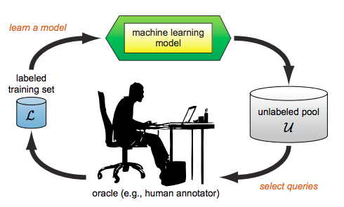
Active learning
Interactive ML : Abundant labelled data, but expensive labeling
learning algorithm can interactively query a user for interesting of difficult eg: uncertainty sampling
Algorithm centric research - simulates an expert
More focus on the domain experts: challenge to provide correct labels as the model matures and selects more uncertain instances,
Difficult to know when to stop “Teaching” the model
Explainable AL

Slide 3
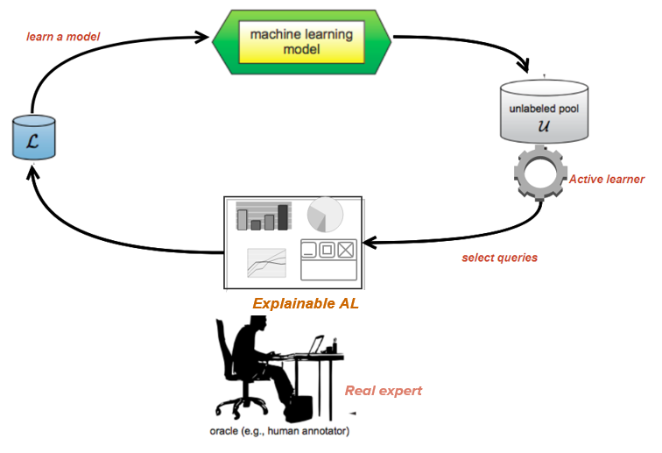
AL framework
Understanding AL strategies: Visualizing active learning strategies – Insight into AL algorithm – more useful to data scientists, researchers
Guided annotation
Generating queries that are more transparent and easier to analyze and annotate – useful to domain experts
Notes:
a tight interaction loop that transparently presents how every human input impacts the model, so that the non-ML-experts could adapt their input to drive the model into desired directions

Slide 4

Part 1: Active learning exploration
Prototype tool to perform BMAL
Insight into the operation of various selections strategies
Uncertainty maps, cluster visualization and uncertainty changes over different batches
Supports BMAL algorithms:
ranked batch mode – top N uncertain examples
k-means uncertain – most uncertain point of the cluster
k-means closest – closest point to the centre

Slide 5
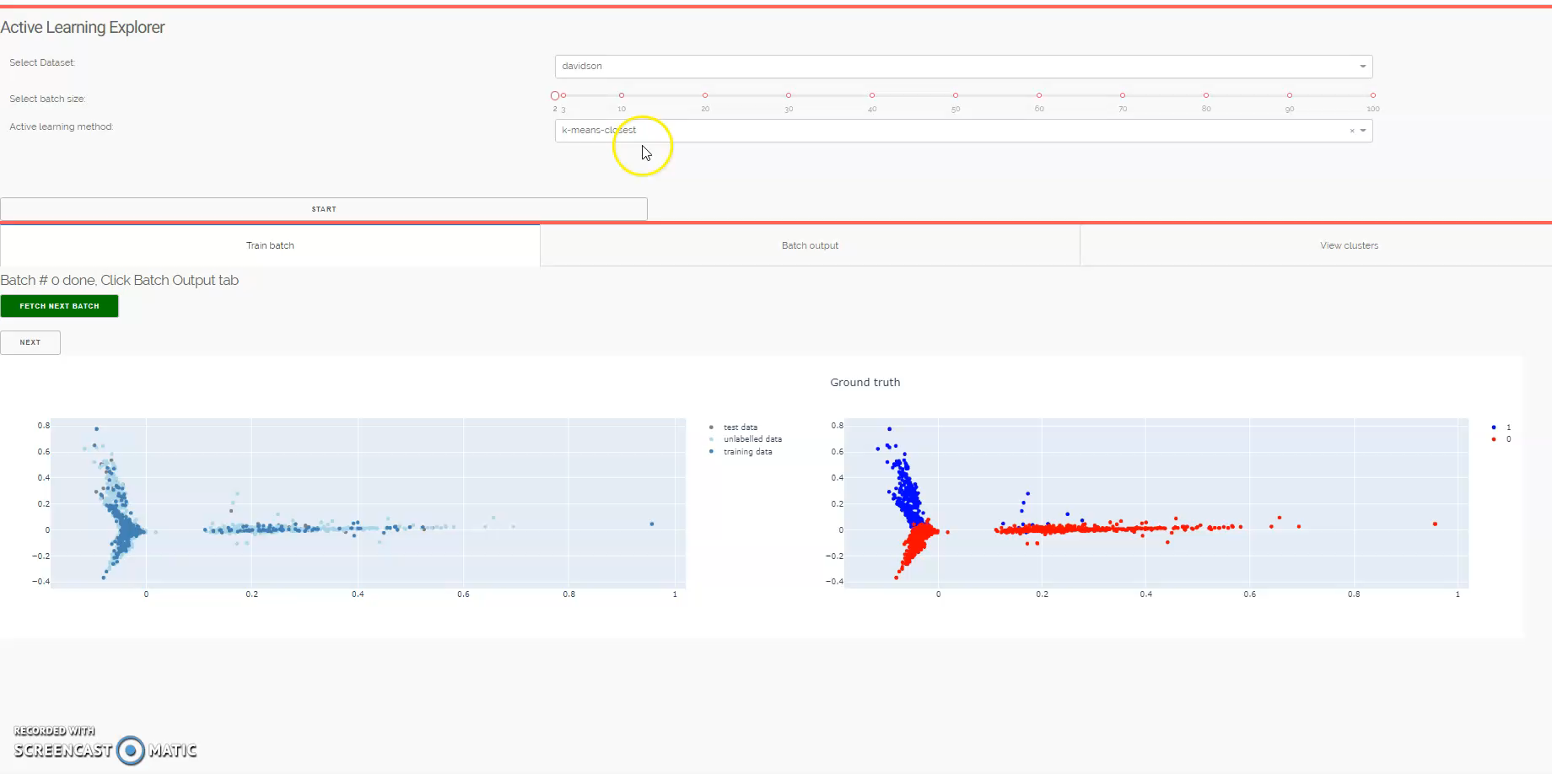
DEMO: Visualizing active learning selection strategies

Slide 6

Part 2: Guiding experts with explanations
How to explain instances within batches?
Categorization can accelerate decision making: How can we create similar groups which are meaningful and easier to label?
Using explanations as a guide to speed-up large scale annotation

Slide 7
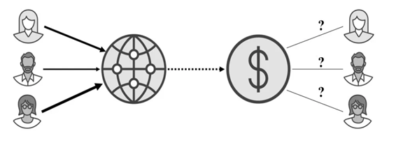
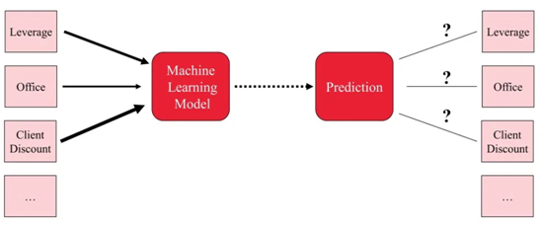
SHAPELY VALUES
Game theory
EXPLAINABILITY
Used in game theory: How to fairly distribute payout among multiple players with different skills?
How to fairly distribute a prediction among different features?

Slide 8
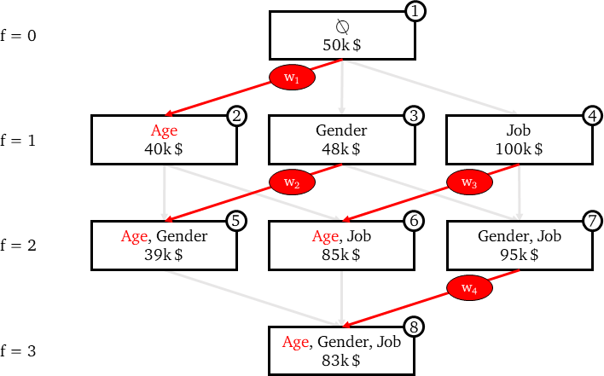
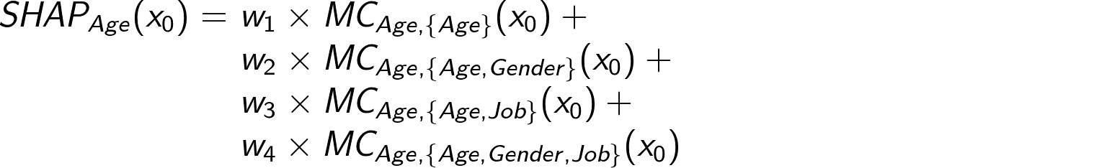
Basic idea of shapely explanations
Find individual contribution from marginal contributions
2^F models
Each edge represents the marginal contribution brought by a feature to a model.

Slide 9
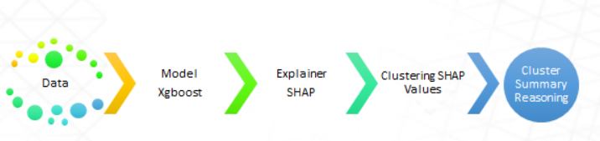
Descriptive clustering approach
Clustering is usually performed in feature space
Instead, If we cluster instances by explanation similarity:
improve cluster homogeneity
improve understanding of model by expert
Guide the expert in decision making
instead of opaquely requesting instance labels, the model presents its understanding of the data, in terms of the explanation
STEPS: Generate clusters -> explain the clusters
Pipeline of steps for explainable clustering

Slide 10
Models
We generated SHAP clusters based on different models & datasets:
Dataset | Instances | Type | Models
Hate speech datasets Hate-xplain benchmark | 5000 - 10000 | text | SVM, Gradient Boosting classifiers, LSTM
Yelp food reviews | 1000 | text | SVM, Gradient Boosting classifiers, LSTM
Bank customer reviews | 500 | text | SVM, Gradient Boosting classifiers, LSTM
CIFAR | 60000 | image | VGG-16
Covid x-rays, Pneumonia | 951, 8000 | image | VGG-19, Densenet, Resnet

Slide 11
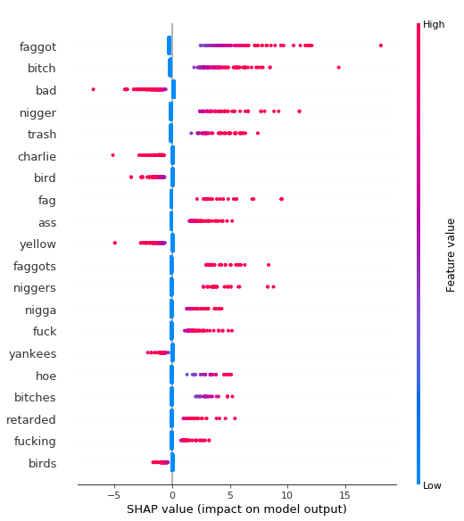
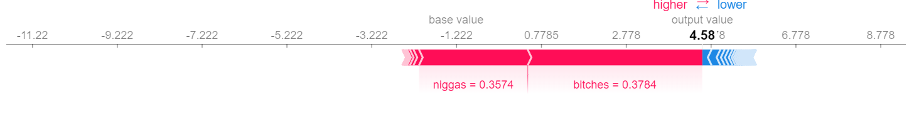
Shapely explanations
Global summary of features for Hate-speech
Explanation of a single instance for hate-speech
niggas wear wigs more than bitches these days
prediction: HATE
True label : HATE
Each point on the summary plot is a Shapley value for a feature and an instance. The color represents the value of the feature from low to high.

Slide 12
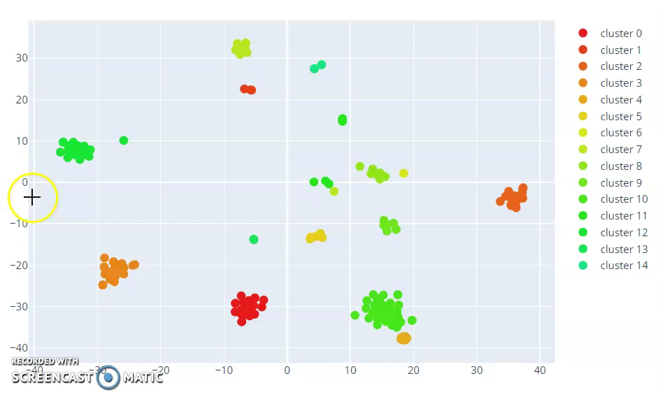
Clustering approach
We cluster instances based on model explanations (shapely values).
Instances within the cluster have common explanations and key contributors to prediction.
For example take a look at these clusters from sentiment analysis

Slide 13
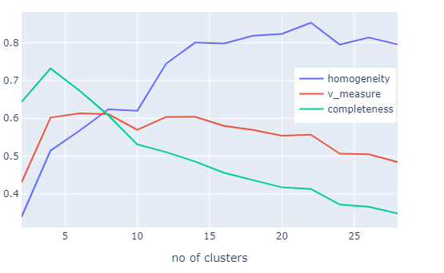
Cluster size and homogeneity
We can achieve homogeneity of 50 - 80%
We want to improve homogeneity as long as k is not too large
Number of instances per cluster a domain expert can effectively handle
Fig. shows homogeneity and completeness for clustering 500 instances from hate-speech analysis dataset.
500 – 25 clusters

Slide 14
Prototype guided annotation tool
Train a model based on a small amount of available data (say 50% of the dataset)
Use SHAP explanations cluster unlabeled data pool.
Provide the whole cluster to label.
Highlight top N key features (Common explanations)

Slide 15
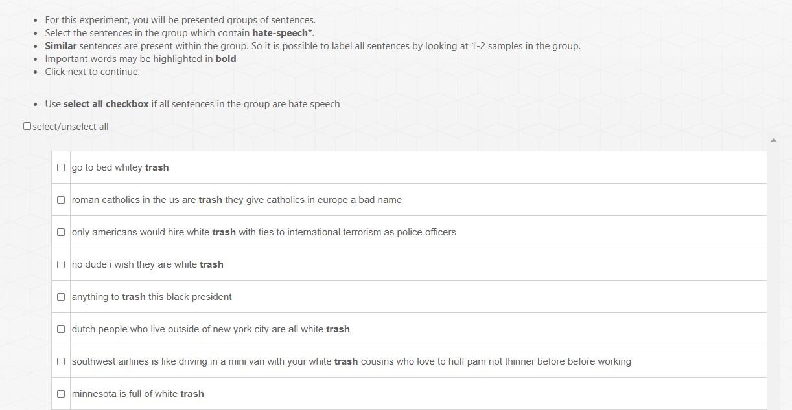
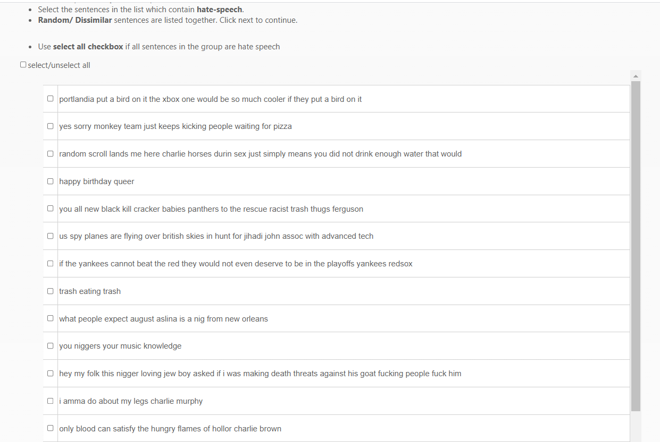

Slide 16
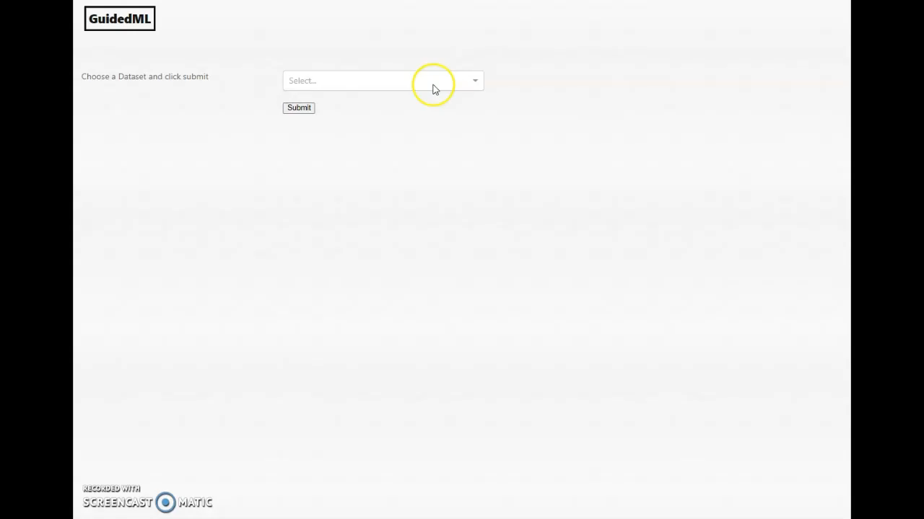
Short demo of faster annotation by guiding the expert

Slide 17
Guided -> active learning
Option 1: Uncertainty sampling followed by clustering
OPTION 2: clustering followed by uncertainty sampling/ranking
Perform uncertainty sampling from unlabeled data
Cluster the sampled data points using SHAP clustering
This could not work in some cases – for ex top 10% of uncertain samples may not group together well, the rest may group well.
Check if uncertainty is similar within clusters
If it is similar: Prioritize clusters based on uncertainty
If it is different: Highlight the most uncertain samples within a cluster?! Or rank clusters based on average uncertainty

Slide 18
UNCERTAINTY WITHIN CLUSTERS

Slide 19
Conclusion & Future work
Initial experiments with guided approach : results in a 2-3x improvement in annotation speed when compared to individual labelling
Exploring uncertainity with explainability : Introduce a quantified notion of uncertainty, the idea that an algorithm may be less certain about its decisions on some data clusters than others.
Feedback loop:
We focused on model guiding the expert to annotate: what about the other way…Can we get feedback about the “bad clusters” presented by us and use it to improve the model?. How does the human input impact the model?
What kind of feedback do annotators naturally want to provide upon seeing local explanations?
Explanations can bias the annotators input to the models. How can we deal with this?

Slide 20
https://towardsdatascience.com/shap-explained-the-way-i-wish-someone-explained-it-to-me-ab81cc69ef30

Slide 21
Assisting radiologists in triaging
Categorizing into mild, medium, severe cases and explaining why we categorized them,
The expert still labels the samples, we only present them as a cluster

